Slide 1
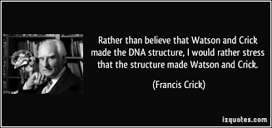
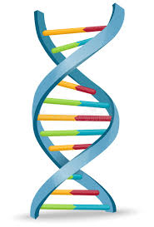

Slide 2
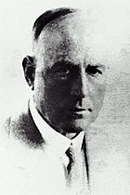
How it all started?
Frederick Griffith (1879–1941) was a British bacteriologist.
1928- studies on pneumonia by infection in mice

Slide 3
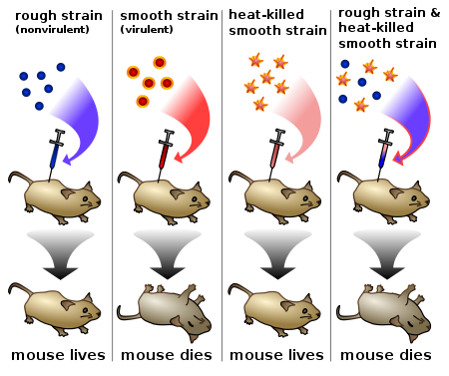
Griffith’s Experiment

Slide 4
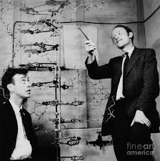
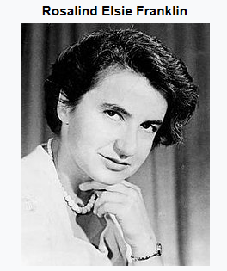
Structure of DNA
Francis Crick
Jonn Watson

Slide 5
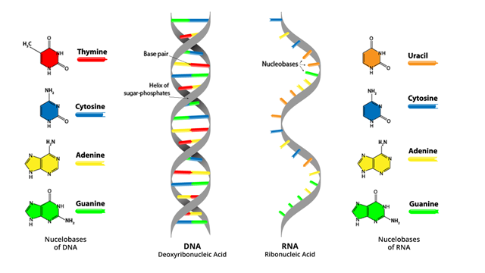
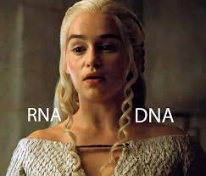
Nuclei acids

Slide 6
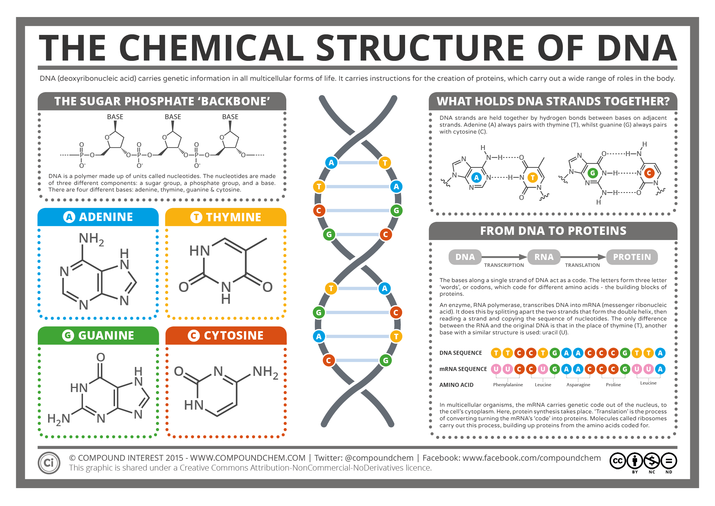

Slide 7
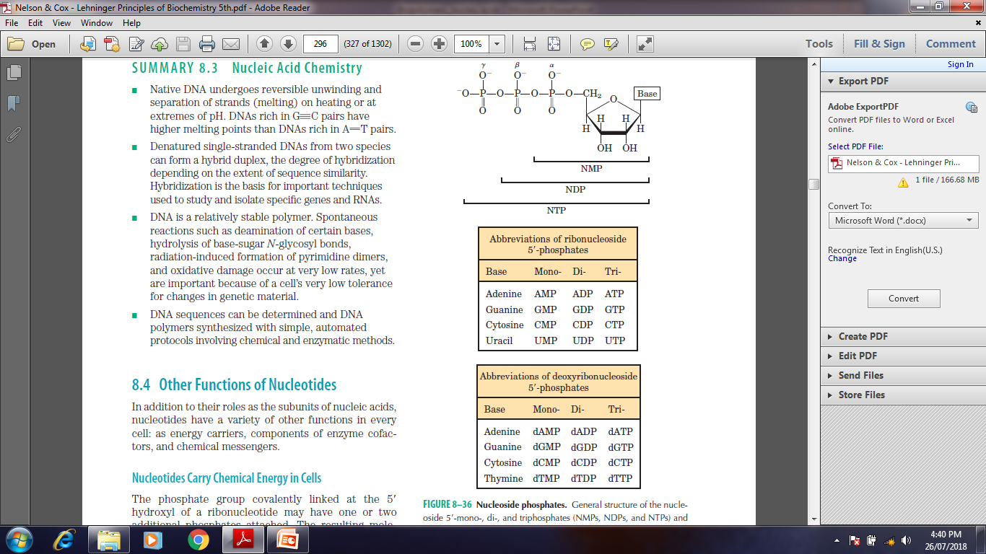
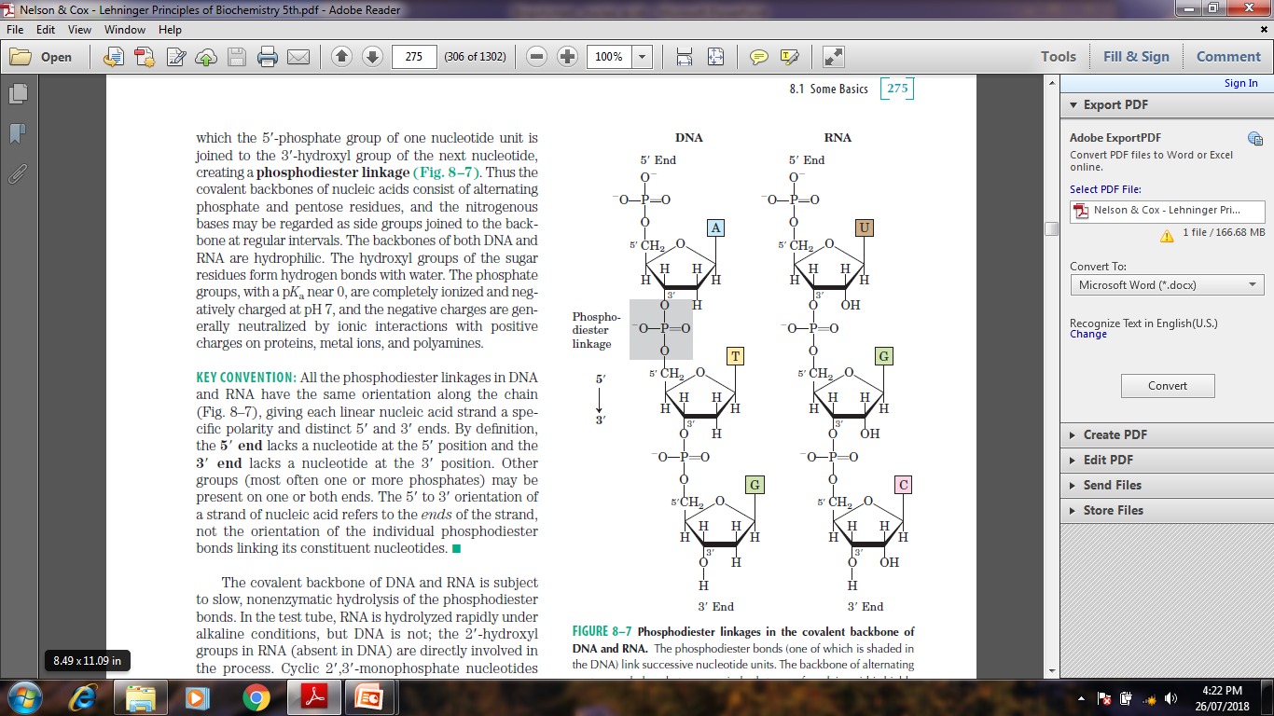
Sugar phosphate back bone

Slide 8
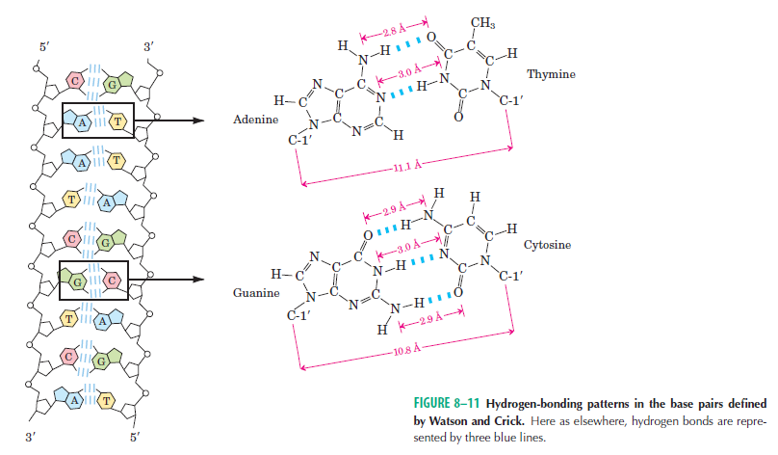
DNA- Base pairing

Slide 9
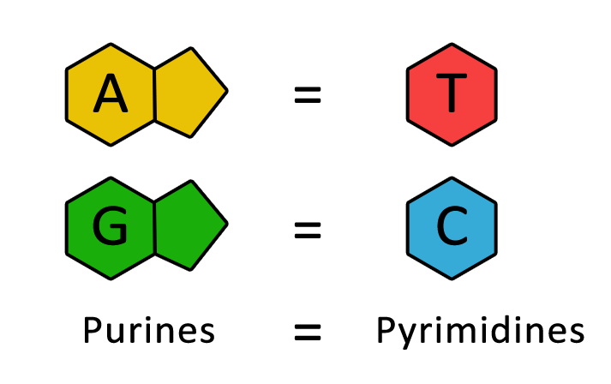
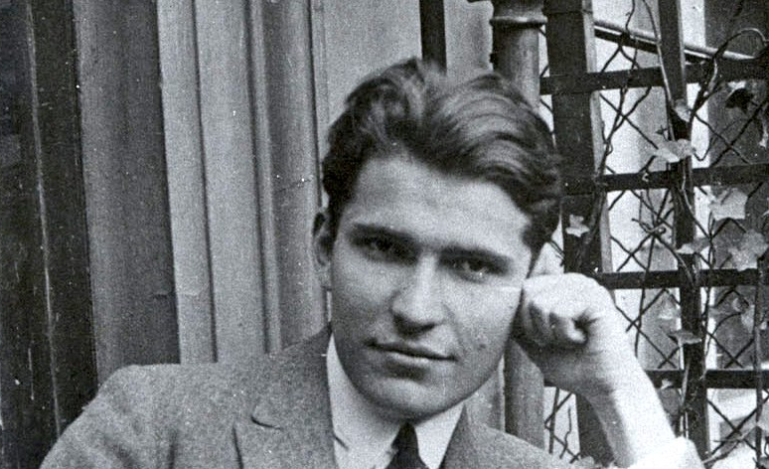
DNA- Base pairing
Chargaff's rules states that DNA from any cell of all organisms should have a 1:1 ratio (base Pair Rule) of pyrimidine and purine bases and, more specifically, that the amount of guanine is equal to cytosine and the amount of adenine is equal to thymine.

Slide 10
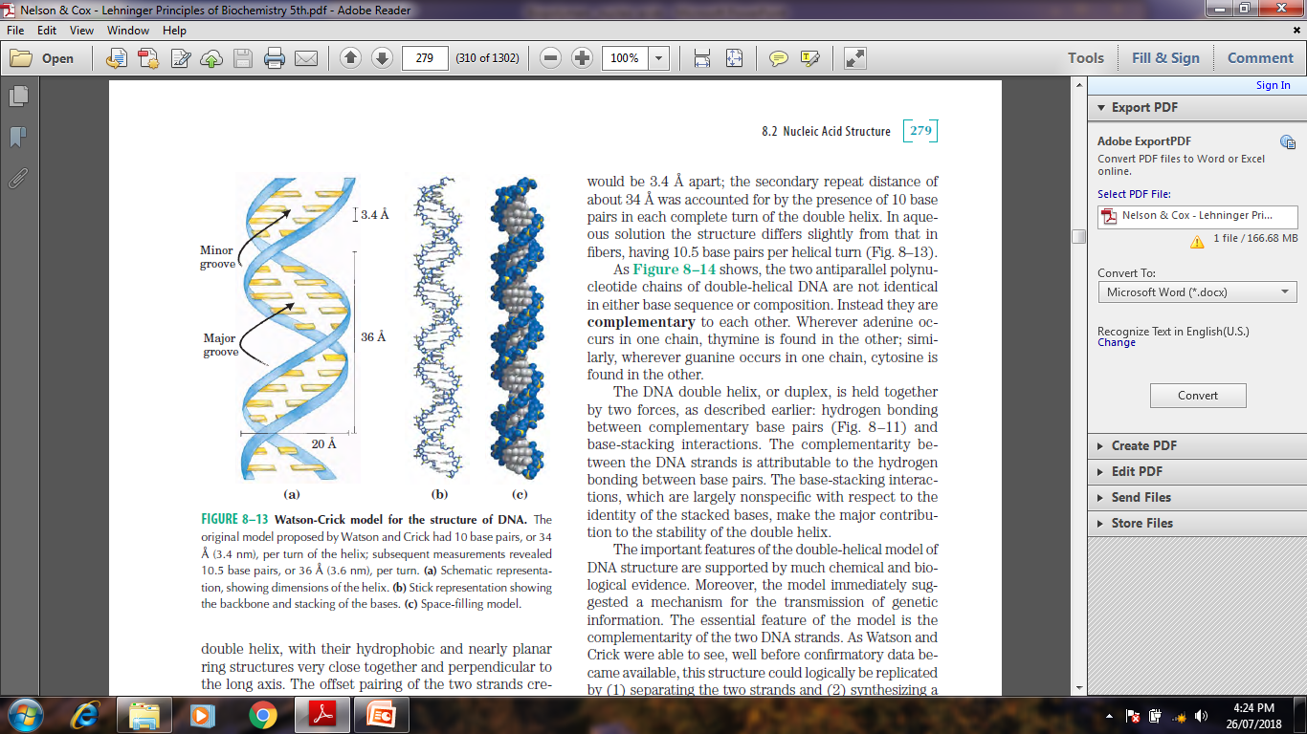
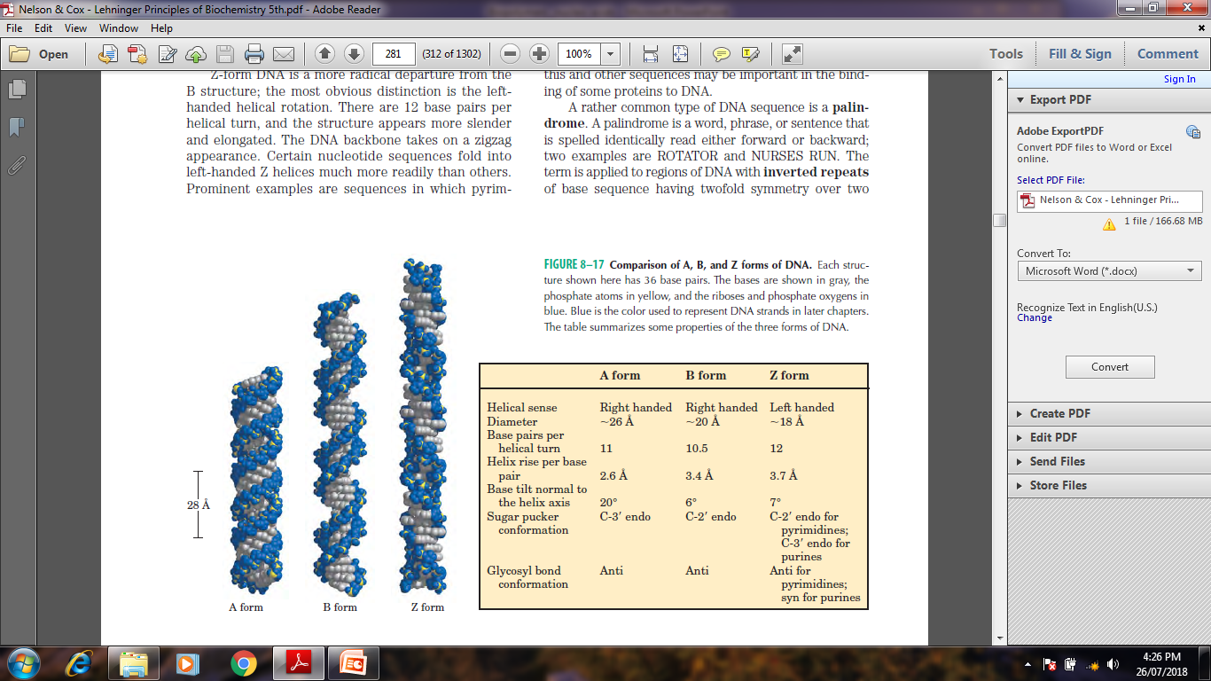
Nuclei acids in solution

Slide 11
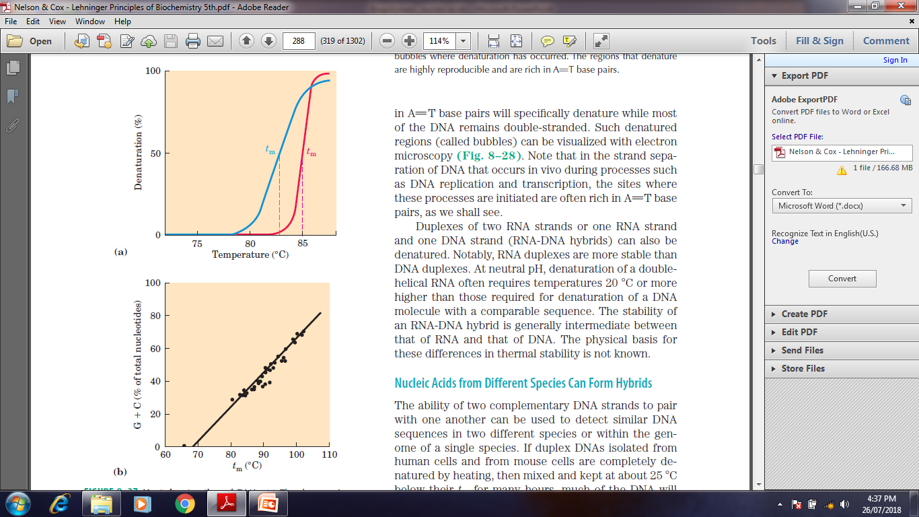
Nuclei acid denaturation

Slide 12
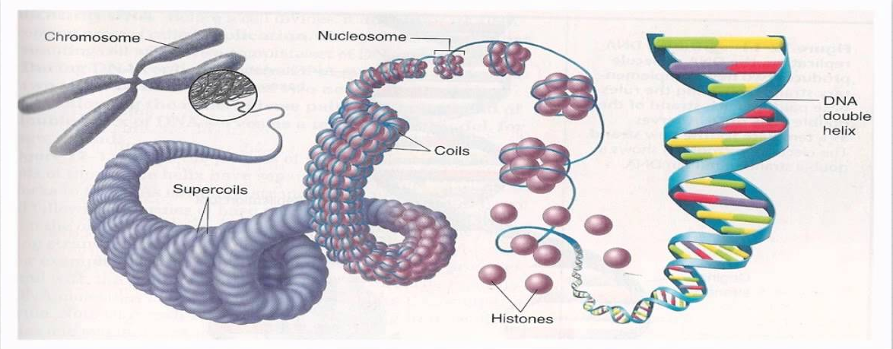
DNA packaging into the nucleus

Slide 13
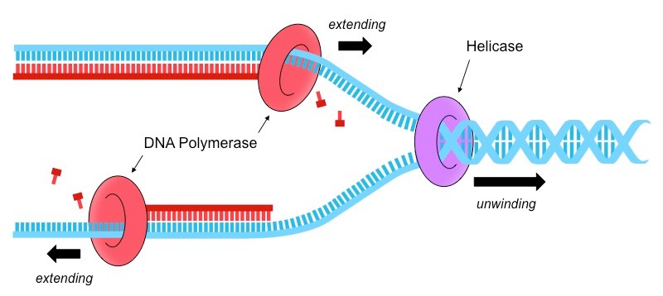
DNA Replication

Slide 14
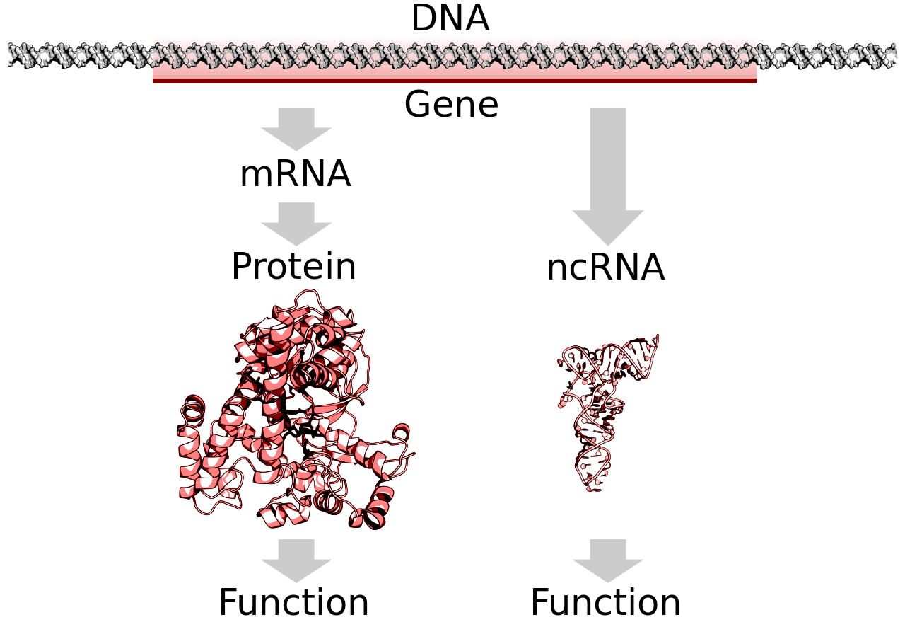
Central dogma

Slide 15
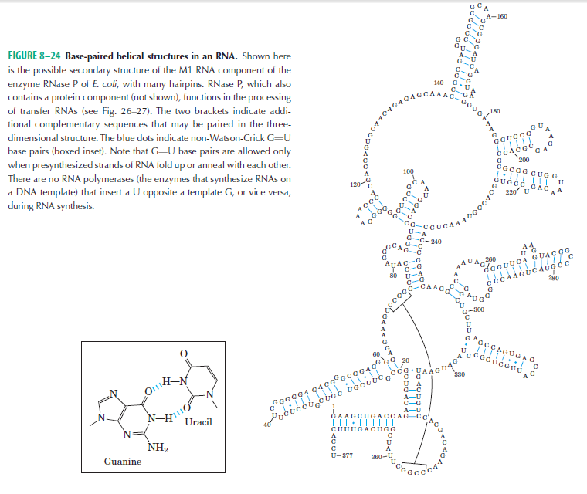
RNA Structure

Slide 16
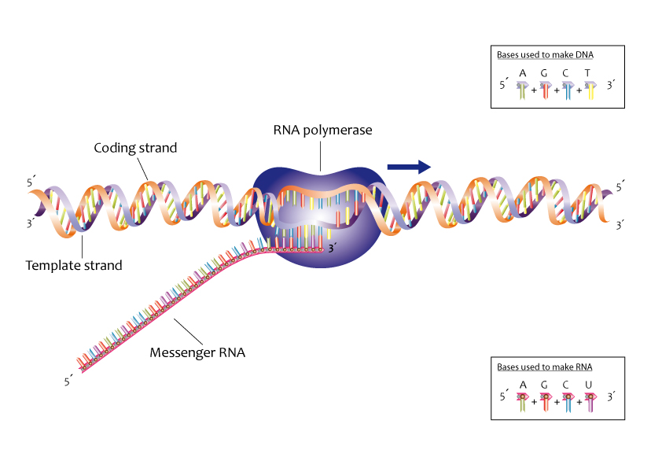
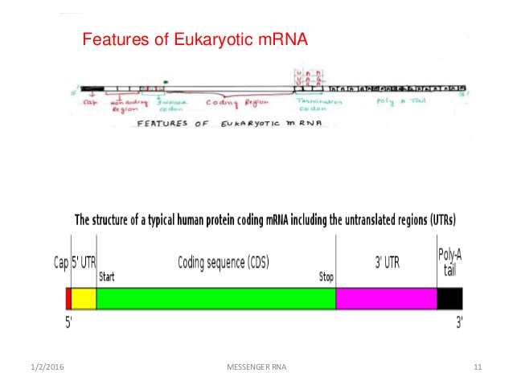
Transcription: process of RNA synthesis

Slide 17
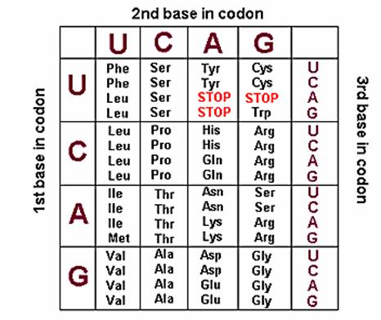
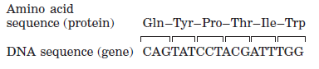
Translation

Slide 18
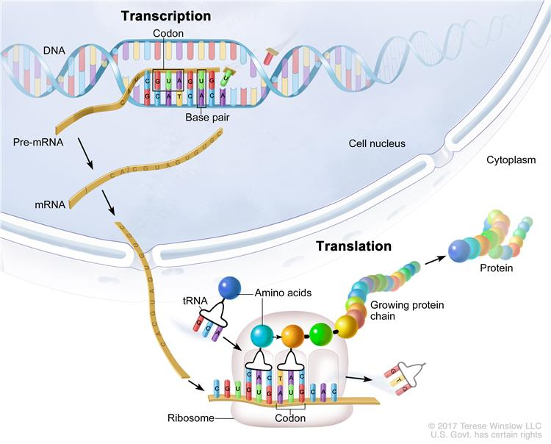
Translation

Slide 19
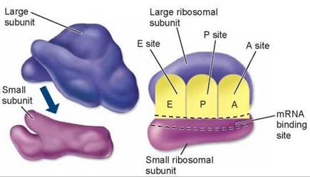
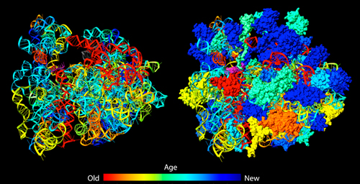
Machinery for Translation: Ribosome

Slide 20
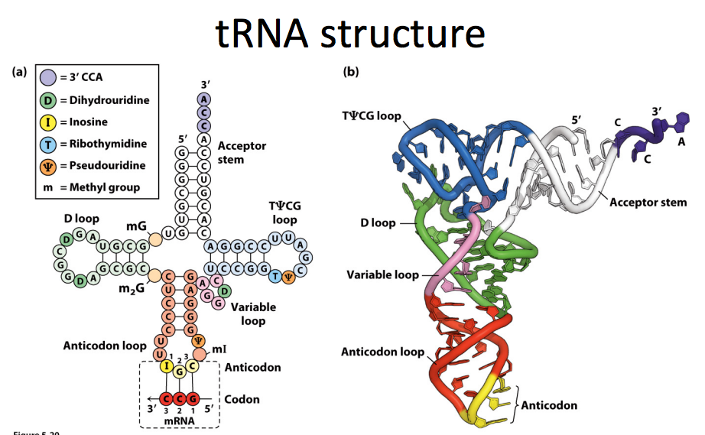

Slide 21
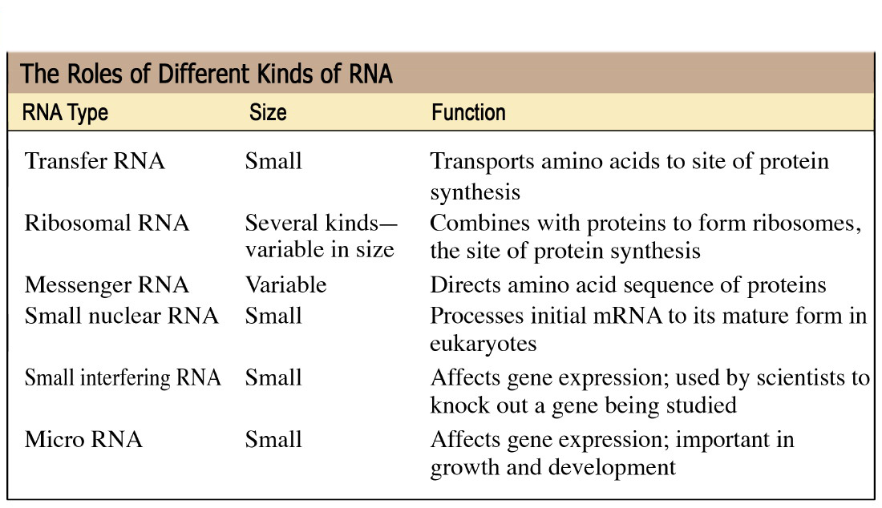
Types of RNA

Slide 22
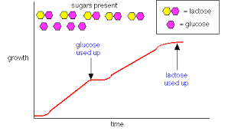
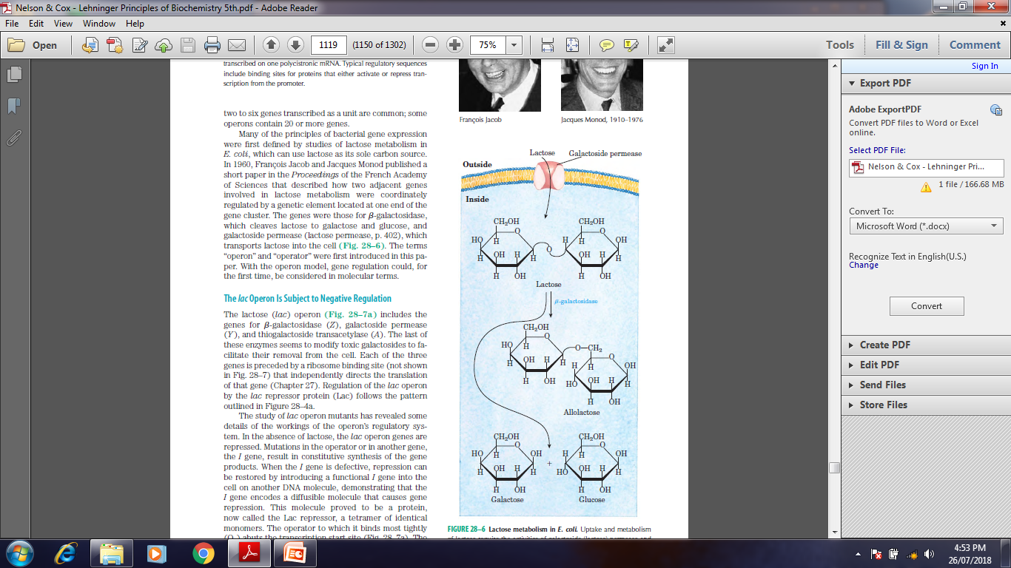
Gene regulation in action

Slide 23
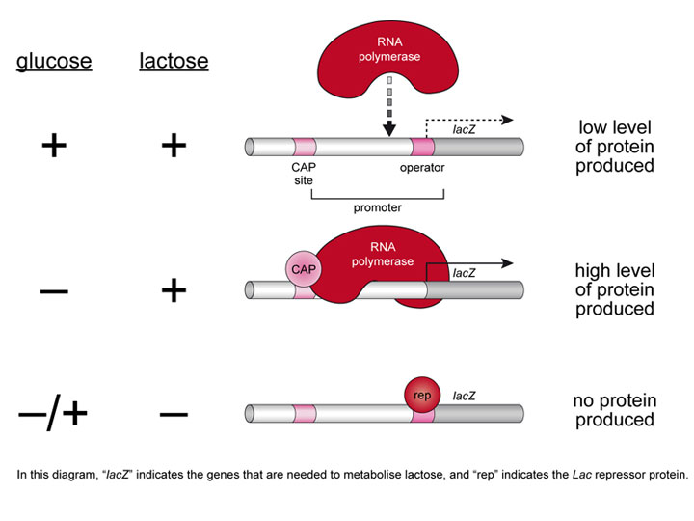
Gene regulation in action

Slide 24
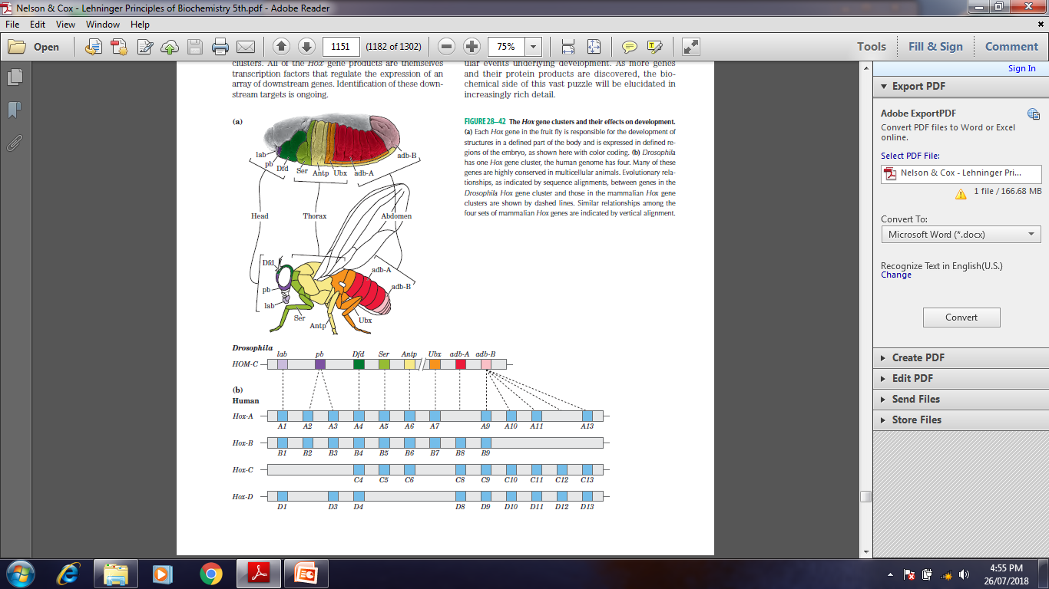
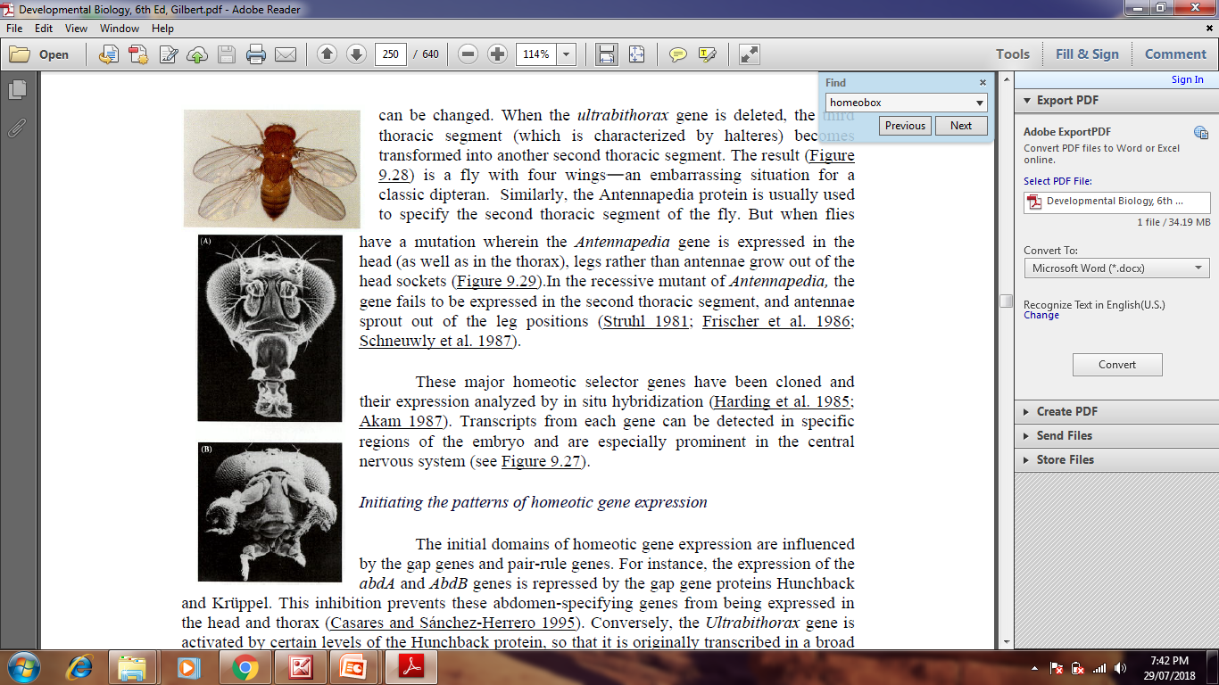
Gene function during development

Slide 25
References:
1. Nelson And Cox, Lehninger Principles of Biochemistry, 6th edition
2. Bioinformatics: Joel Keizer
3. Images: Search engine Google.
4. Harper’s Biochemistry 26th Edition.
5. Genes- VIII, Lewin
6. Developmental Biology by Gilbert 7th Edition

Slide 26
